Slide 1
Inter-Domain Routing
Exercises ANS
Lecture 8 (Routing 5)
Slides credit: CS 168 @ UC Berkeley
Notes:
Slides template credit: Josh Hug, Lisa Yan

Slide 2
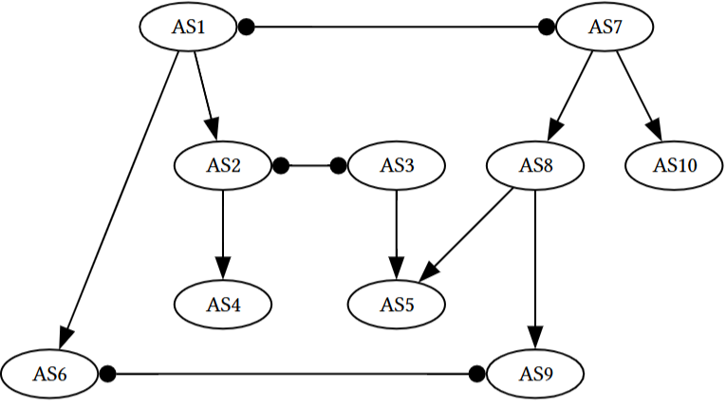
Q1. BGP
Consider the following configuration of autonomous systems and their relationships.
A square-triangle line indicates a provider-customer relationship, and a circle-circle line indicates a peer relationship. We have two tier 1 providers (AS1 and AS7). Assume we are using the following selection and export rules for all ASes:
Selection: Prefer to send data through customers > peers > providers in order to minimize costs.
Export: To customers, advertise all paths. To all other ASes, advertise only paths to customers (and paths to your own AS, of course).
1) A user in AS4 tries to send data to a friend in AS5. What path (if any) would the data take to get to the friend?
2) A user in AS6 tries to send data to a friend in AS5. What path (if any) would the data take to get to the friend?
3) A user in AS1 tries to send data to another user in AS9. What path (if any) would the data take?
Notes:
then after that after the midterm maybe we switch into layer four
14:15
and we start thinking about how do you actually build a reliable protocol so we showed you that little super simple Bob
14:21
sending 10 packets reliability protocol and some people pointed out there are some bugs in that that we didn't really
14:27
address and you're right a real solid state-of-the-art reli reliability protocol will take us four lectures to
14:34
build so we're going to spend two lectures building TCP to ensure reliability and then we'll spend two
14:40
more lectures talking about congestion control so that we ensure that the NH host don't overload the links and these
14:47
are associated with the third project which is all about transport and implementing
14:52
TCP and then after that two lectures at layer seven so we're basically moving up the stack and at layer seven there
14:59
there's two applications that we'll talk about one of them is DNS one of them is HTTP I won't talk about them any further
15:05
here because you'll get them a lot later but there are examples of things that we can build on top of the network to make
15:12
everything work and once we've traveled across all the layers in lecture 16 and 17 we'll go back and clean up all the
15:19
little missing pieces that we haven't really touched yet to form what we call the end to endend picture so by lecture
15:26
17 you will finally get the ultimate picture of what exactly happens when I send a packet from point A to point B
15:32
all of the missing pieces will get filled in we'll go through all these protocols that didn't really fit anywhere else but have to be covered and
15:40
we'll also spend a little bit of time at Layer Two and everything will be connected up so we'll spend a lot of time at layers three four and seven and
15:47
once we do that we'll Circle back and tie it all together in lectures 16 and 17 so that's the next part of the
15:57
semester

